Slide 1


Announcing ACR Build A primitive of container lifecycle management
aka.ms/acr/build

Slide 2






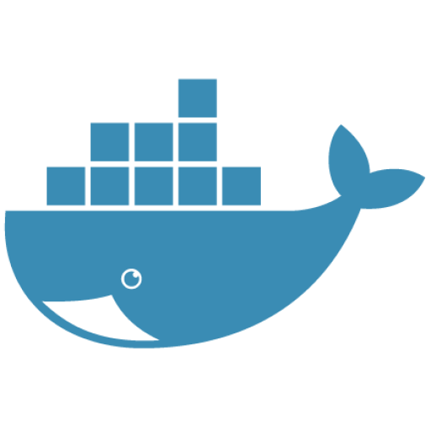





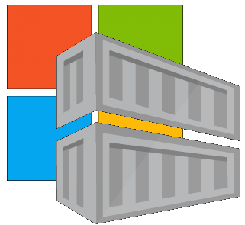



Container Lifecycle Primitives
Host agents monitor, protect and report running containers
3
Container Service
Container Instances
Source Code Control
(SCC)
Build/CI,
Integrate,
Test
CD, Deploy
7
App Services
Upon release, set released flag in ACR (ACR-Auto-purge policies)
Service Fabric
.NET
6
Base Image Index
4
8
1
2
Azure Functions
Docker Hub
ACR Build
Azure Container Registry
IoT
Azure Container Registry
Image Security Scanning
Secure by default
Microsoft Container Registry
Inner-Loop
Azure Batch
Run
5
Code
Validate
Debug

Slide 3
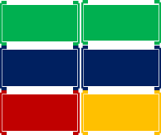
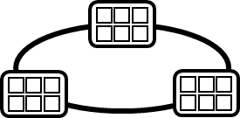
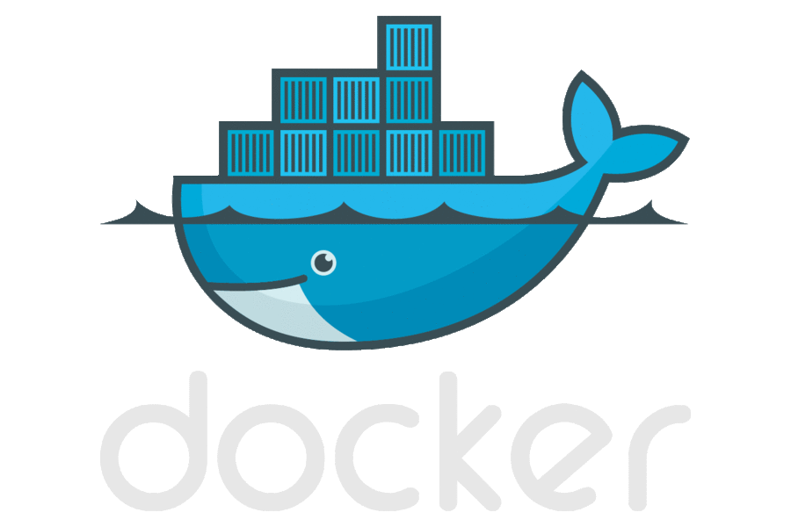

Today’s Container DevOps Workflow
Today’s Container DevOps Workflow
Container Service
OS & Framework Patching
What happens when developers stop making code changes?
Run, Manage
Container Instances
Source Code Control
(SCC)
Build/CI,
Integrate,
Test
CD, Deploy
App Services
Production
environments
Service Fabric
Azure Functions
IoT
Inner-Loop
Azure Batch
Run
Monitor and Diagnose
Code
Validate
Debug

Slide 4
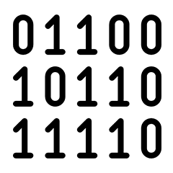






ACR Build: Container OS & Framework Patching
.NET
Registries
Docker Hub
MCR
ACR
Build Triggers
SCC Providers
ACR Build
Azure Container Registry
aka.ms/acr/build

Slide 5


Dockerfile FROM
Functional Tests
Base Images
Commit Id
Build-task
Id
Context
Dependencies
ACR
d5ab1fa
fx:1
fx:1^{(a)}
fx:1
Web-Build
1
fx:1
web:sha@la
web:1
deploy/test
deploy
web:1
web:1
test:t
Context
d5ab1fa
test:1
Dependencies
web:1
Integration Env
FROM jenga.azurecr.io/baseimages/fx:1
COPY . /output
EXPOSE 80
ENTRYPOINT ["entryPoint"]
If docker build succeeds (including any unit tests),
Save the context & base image dependencies
web:1
az acr build-task create \
–n Web-Build \
–t web:${{.Build.ID}} \
–c github.com/demo42/web \
–-git-access-token $PAT \
–r jenga
Staging Env

Slide 6
Dockerfile FROM
Functional Tests
Base Images
Commit Id
Build-task
Id
Context
Dependencies
ACR
fx:1^{(a)}
fx:1
d5ab1fa
Web-Build
1
fx:1
web:sha@la
web:1
deploy/test
deploy
Context
fx:1^{(b)}
fx:1^{(b)}
2
fx:1^{(b)}
web:sha@ya
web:2
deploy/test
deploy
web:2
web:2
d5ab1fa
test:2
test:2
Dependencies
fx:1^{(a)}
web:2
fx ships an OS &/or FX Patch, using the stable 1 tag
The build-task is monitoring changes based on the last build
Integration Env
Base image updates restore the previous context
If Build & Unit Tests Succeed,
Update the base image dependencies
web:2
Staging Env

Slide 7
Dockerfile FROM
Functional Tests
Base Images
Commit Id
Build-task
Id
Context
Dependencies
ACR
fx:1^{(a)}
d5ab1fa
Web-Build
fx:1
fx:1
Web-Build
1
web:sha@la
web:1
deploy/test
deploy
Context
fx:1^{(b)}
fx:1^{(b)}
2
fx:1^{(b)}
web:sha@ya
web:2
deploy/test
deploy
web:2
web:2
ef26q5c
test:2
d5ab1fa
test:3
fx:2^{(d)}
fx:2^{(d)}
fx:2
ef26q5c
3
fx:2^{(d)}
web:sha@qe
web:3
deploy/test
deploy
web:3
web:3
Dependencies
test:4
Dependencies
fx:1^{(a)}
fx:1^{(b)}
web:3
FROM jenga.azurecr.io/baseimages/fx:2
COPY . /output
EXPOSE 80
ENTRYPOINT ["entryPoint"]
Integration Env
web:2
web:3
If docker build succeeds (including any unit tests),
Save the context & base image dependencies
Staging Env
Container OS & Framework Patching

Slide 8
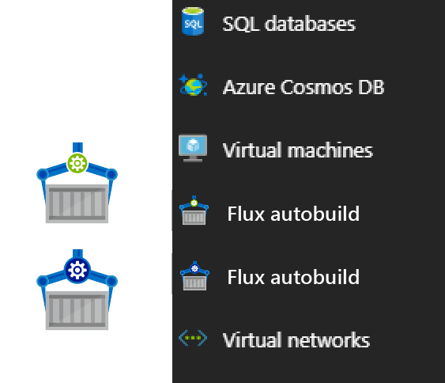


Contoso (Returns)
1 Pull Request
= 1 Build
= 1 Push
= 1 Scan
= 1 Test
= 1 Deploy
$$(1pr=1b+1p+ 1t+1d) ∗life of development$$
Contoso (*)
= 1 Build
= 1 Push
= 1 Scan
= 1 Test
= 1 Deploy
= 1 Build
= 1 Push
= 1 Scan
= 1 Test
= 1 Deploy
= 1 Build
= 1 Push
= 1 Scan
= 1 Test
= 1 Deploy
.NET
Northwind
= 1 Build
= 1 Push
= 1 Scan
= 1 Test
= 1 Deploy
= 1 Build
= 1 Push
= 1 Scan
= 1 Test
= 1 Deploy
= 1 Build
= 1 Push
= 1 Scan
= 1 Test
= 1 Deploy
Smart Hotel 360
= 1 Build
= 1 Push
= 1 Scan
= 1 Test
= 1 Deploy
= 1 Build
= 1 Push
= 1 Scan
= 1 Test
= 1 Deploy
= 1 Build
= 1 Push
= 1 Scan
= 1 Test
= 1 Deploy
Adventure Works
= 1 Build
= 1 Push
= 1 Scan
= 1 Test
= 1 Deploy
= 1 Build
= 1 Push
= 1 Scan
= 1 Test
= 1 Deploy
= 1 Build
= 1 Push
= 1 Scan
= 1 Test
= 1 Deploy
Fabrikam
= 1 Build
= 1 Push
= 1 Scan
= 1 Test
= 1 Deploy
= 1 Build
= 1 Push
= 1 Scan
= 1 Test
= 1 Deploy
= 1 Build
= 1 Push
= 1 Scan
= 1 Test
= 1 Deploy
$$1patch=cust ∗apps ∗ \left(1b+1p+ 1t+1d\right)∗life of the app$$

Slide 9
ACR Build
Enabling
Container Lifecycle Management
aka.ms/acr/build

